Slide 1
Capstone Project
Coronavirus Tweet Sentiment Analysis
Vikramaditya Sah

Slide 2
CONTENTS
Problem Statement
Data Pipeline
Data Summary
EDA
Classiﬁcation models
Performance Metrics
Conclusion

Slide 3
Problem Statement​
This challenge asks you to build a classiﬁcation model to predict the sentiment of COVID-19 tweets.The tweets have been pulled from Twitter and manual tagging has been done then.​
The names and usernames have been given codes to avoid any privacy concerns.​
​
You are given the following information:​
Location​
Tweet At​
Original Tweet​
Label​

Slide 4
DATA PIPELINE
Data overview
Treating null values
EDA
Text Preprocessing
Data bifurcation
Vectorization
Test-train data split
Classiﬁcation analysis
Evaluation metrics comparison

Slide 5
Data Summary
Data set - Coronavirus Tweets- Contains tweets about people’s reaction on Covid situation.
rows: 41157
column: 6
The usable features of the dataset are - Orignaltweet and Sentiment.

Slide 6
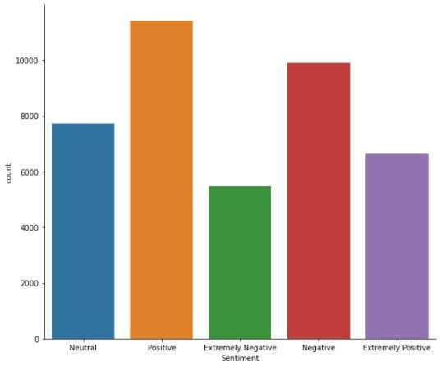
EDAA
TWEET COUNT FOR EACH SENTIMENT

Slide 7
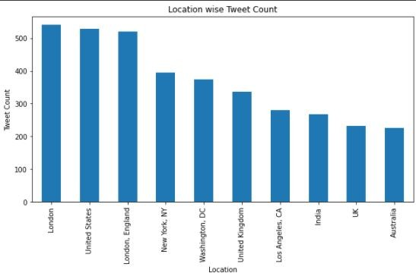
TOP 10 LOCATION BASED ON TWEET COUNT​

Slide 8
TEXT PREPROCESSING
ORIGINAL TWEET-
As news of the regionÂs ﬁrst conﬁrmed COVID-19 case came out of Sullivan County last week, people ﬂocked to area stores to purchase cleaning supplies, hand sanitizer, food, toilet paper and other goods, @Tim_Dodson reports https:/ t.co/cfXch7a2lU
REMOVING LINKS/URLs AND USERNAMES
As news of the regionÂs ﬁrst conﬁrmed COVID-19 case came out of Sullivan County last week, people ﬂocked to area stores to purchase cleaning supplies, hand sanitizer, food, toilet paper and other goods, reports

Slide 9
REMOVING PUNCTUATIONS/NUMBERS/SPECIAL CHARACTERS
As news of the regions ﬁrst conﬁrmed COVID case came out of Sullivan County last week people ﬂocked to area stores to purchase cleaning supplies hand sanitizer food toilet paper and other goods reports
REMOVING STOP WORDS, SHORT WORDS AND STEMMING
news region ﬁrst conﬁrm covid case came sullivan counti last week peopl ﬂock area store purchas clean suppli hand sanit food toilet paper good report

Slide 10
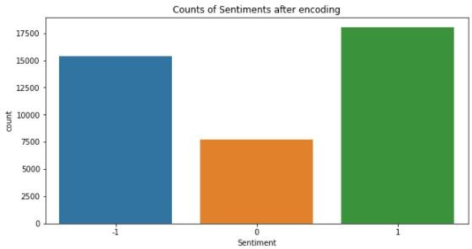
DATA ENCODING
Changing neutral labels as 0
Combining Positive and extremely positive labels as 1
Combining Negative and extremely negative labels as -1

Slide 11
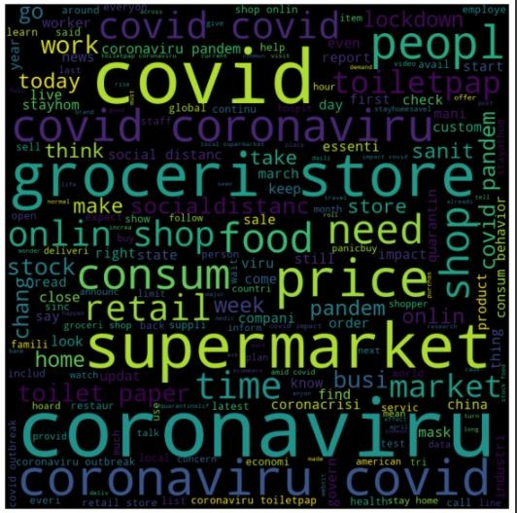
VECTORIZATION and WORD CLOUD

Slide 12
CLASSIFICATION MODELS
The classiﬁcation models used in our project are as follows-
LOGISTIC REGRESSION
RANDOM FOREST CLASSIFIER
XGBoost CLASSIFIER
KNN CLASSIFIER
SVM CLASSIFIER

Slide 13
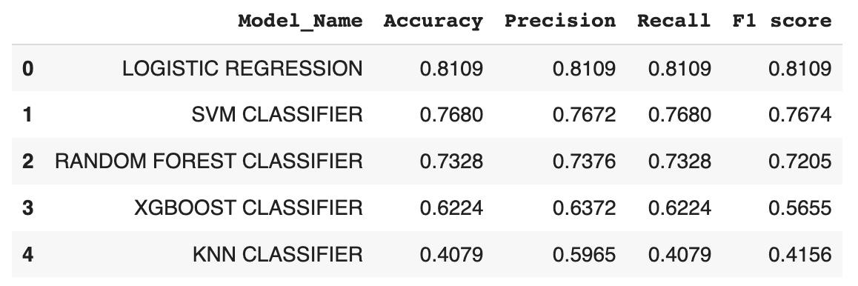
METRIC EVALUATION

Slide 14
Conclusion
We can conclude that Logistic regression is the best model for our dataset, followed closely by SVM classiﬁer and Random Forest classiﬁer. XGboost and KNN classiﬁers did not give a good result compared to others.

Slide 15
Thank You

